Slide 1



IBM Mentor : SUKANTA SARKAR, RAHUL BANGA
EDUNET Mentor: MOHAMMAD SARWAR BABU
Project Presentation Showcase – TEAM 68 FSD
PEOPLE TRACKING APPLICATION
Developed By
Sachin Singh
Doly Tiwari
Daivshila Waghmare
Bhaira Ram Prajapat
Amit Kumar

Slide 2
Quick Intro
In this presentation we will be discussing about the people tracking web application which will be made with full stack development
Key Features
Tracking People
Creating log of each record
Having optimal and better solution in emergencies
Can able to create and edit records easily
No need of pre configured software into web app

Slide 3


Architecture
Application Hosted Environment
SQL SERVER
PHP SERVER
USER
ADMIN

Slide 4
What Behind This
The Background
We all have gone through the situations of emergencies, curfews, lockdowns etc. in our life because of necessity of survival
Somewhere we are failing to provide better results in these situations, how much the positive impact was there still the negative impact was also a lot.
To prevent this negative outcome and maintain proper knowledge of information we should make a better solution

Slide 5
Where we are facing problem
Problem Statement
Due to the recent pandemic situations, we were in lockdown mode and we were not going outside, but people were finding unauthorized alternate ways to go out and to complete their tasks or works. This helped to spread covid-19 even in lockdown also easily.
Lack of Safety
Unaware about people who are affected to that situation or exposed to that atmosphere
Lack of information about people who went outside on what purpose

Slide 6
Where we can implement this
Domain
This solution is not related to any particular domain oriented because the people tracking application can be utilised for any kind of emergencies.
It is very much helpful as logbook of each and every record.
This can be utilised for industries, universities, organizations, hospitals, transportation etc.
People Tracking Application can be a One Stop Solution for al these problems

Slide 7
For whom we are making this
End Users: Govt. / Private / NGO Organizations
Making an digital application
The application covers entire aspects of logging or tracking the user.
Application can be scaled vastly and customizable if the organization needed

Slide 8
Advantages
Innovative Idea
Creating a digital web application to track people based on their purpose and activities and getting insights from the data to avoid negative outcome
Hence we got motivation to make this application in the purpose of tracking people in covid situation, so that they can be tracked by organizations and they can be monitored to avoid negative outcome

Slide 9
What we are choosing
Technology Stack
HTML5, CSS3, JS (Front End)
PHP(Backend)
MYSQL(Database Operations)
Bootstrap(Framework)
Server(Apache)

Slide 10
Working Process: USER
USER Panel
We have 4 steps for users to follow
Signup
Login
Raise a Request
Check the status

Slide 11
Working Process: ADMIN
Admin Panel
We have 4 steps for Admins to follow
Signup
Login
View a Request
Update the status

Slide 12
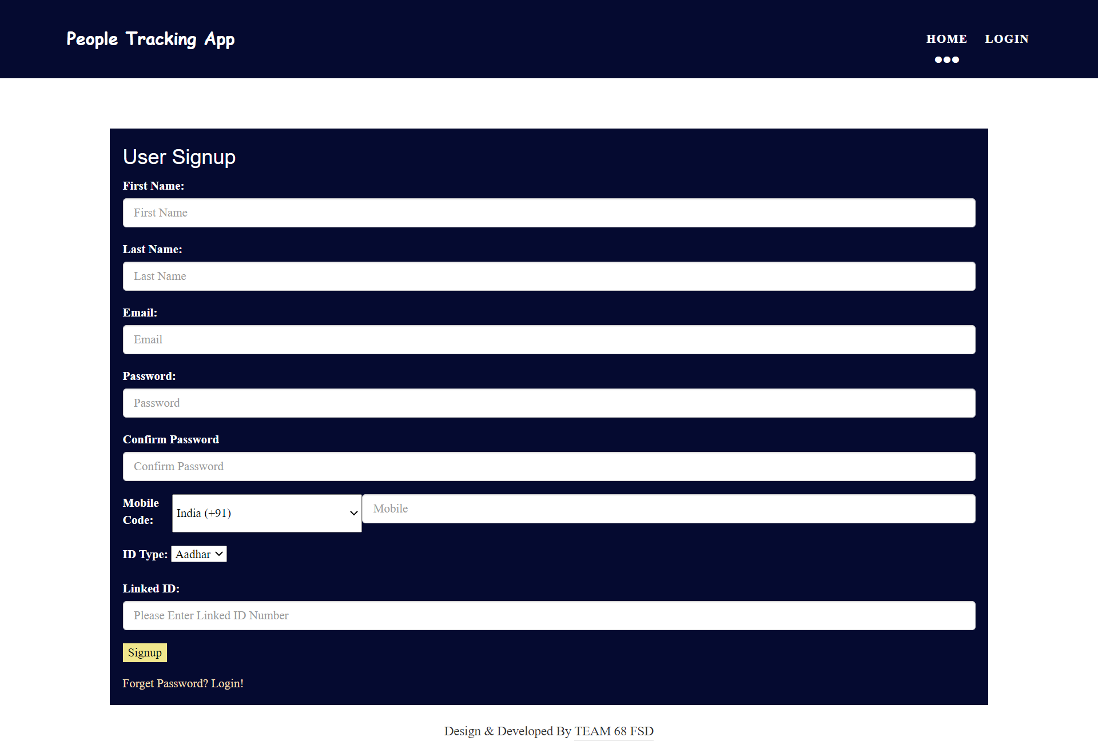
Output Screens
User Signup

Slide 13
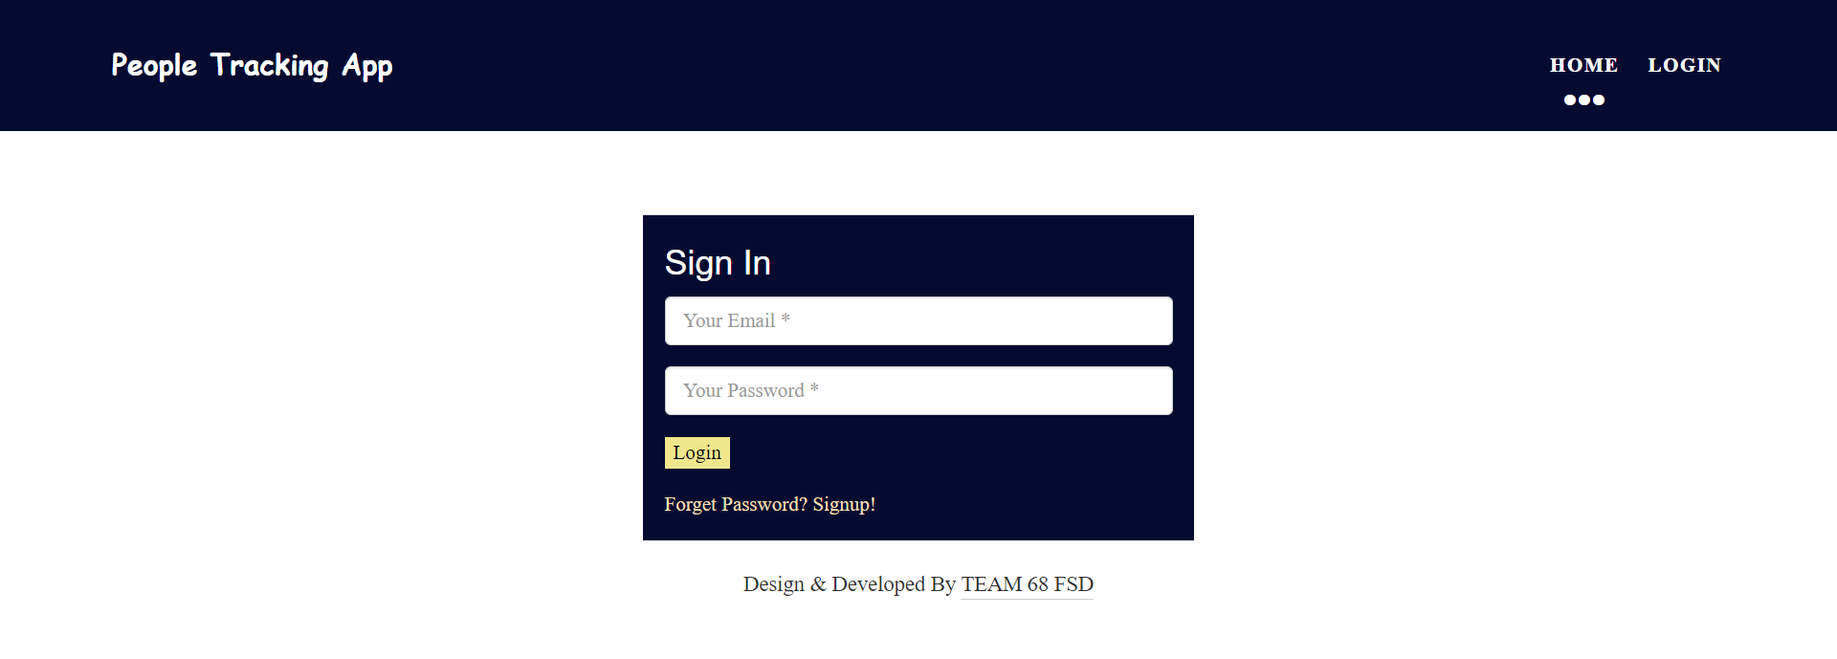
Output Screens
User Login

Slide 14
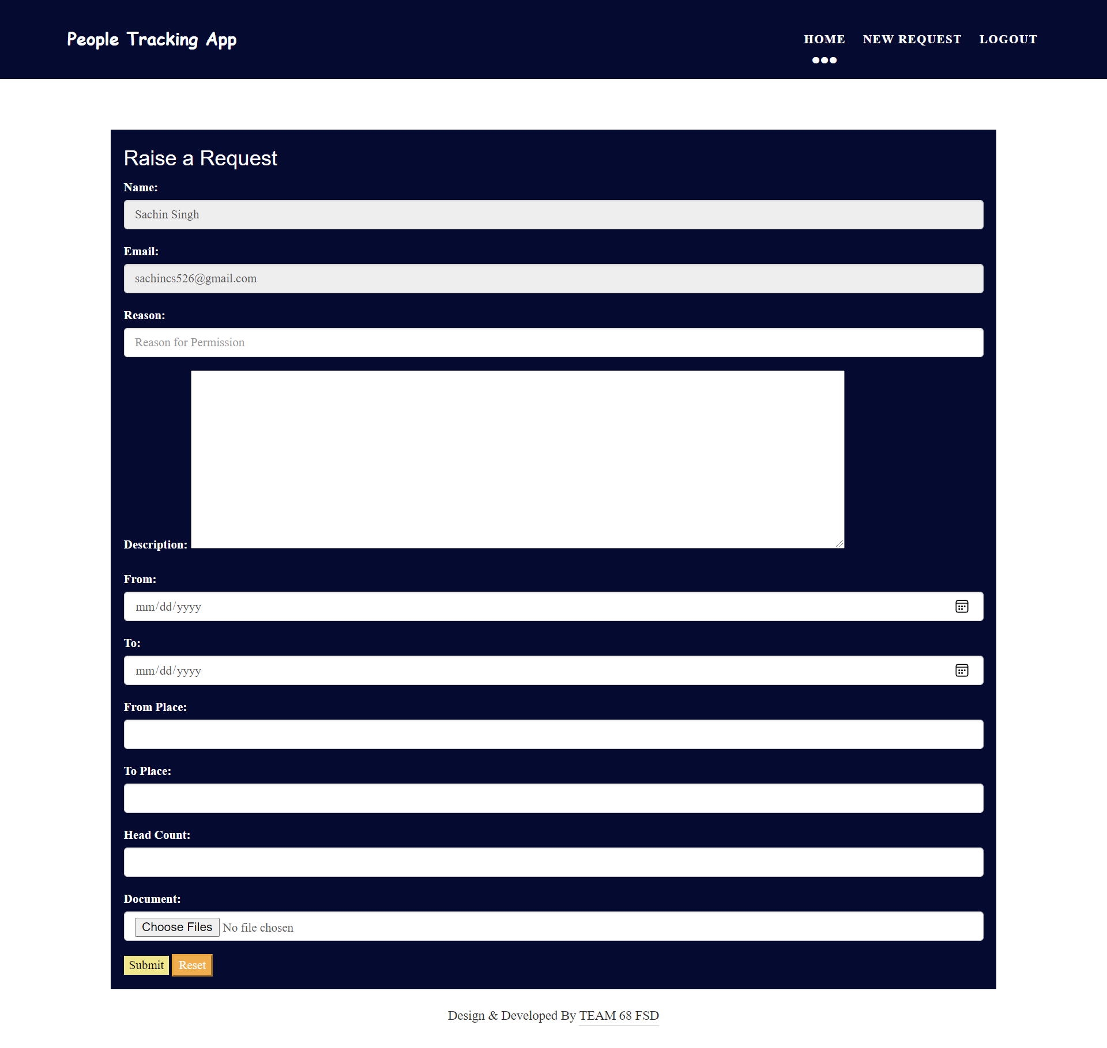
Output Screens
Raise a Request

Slide 15
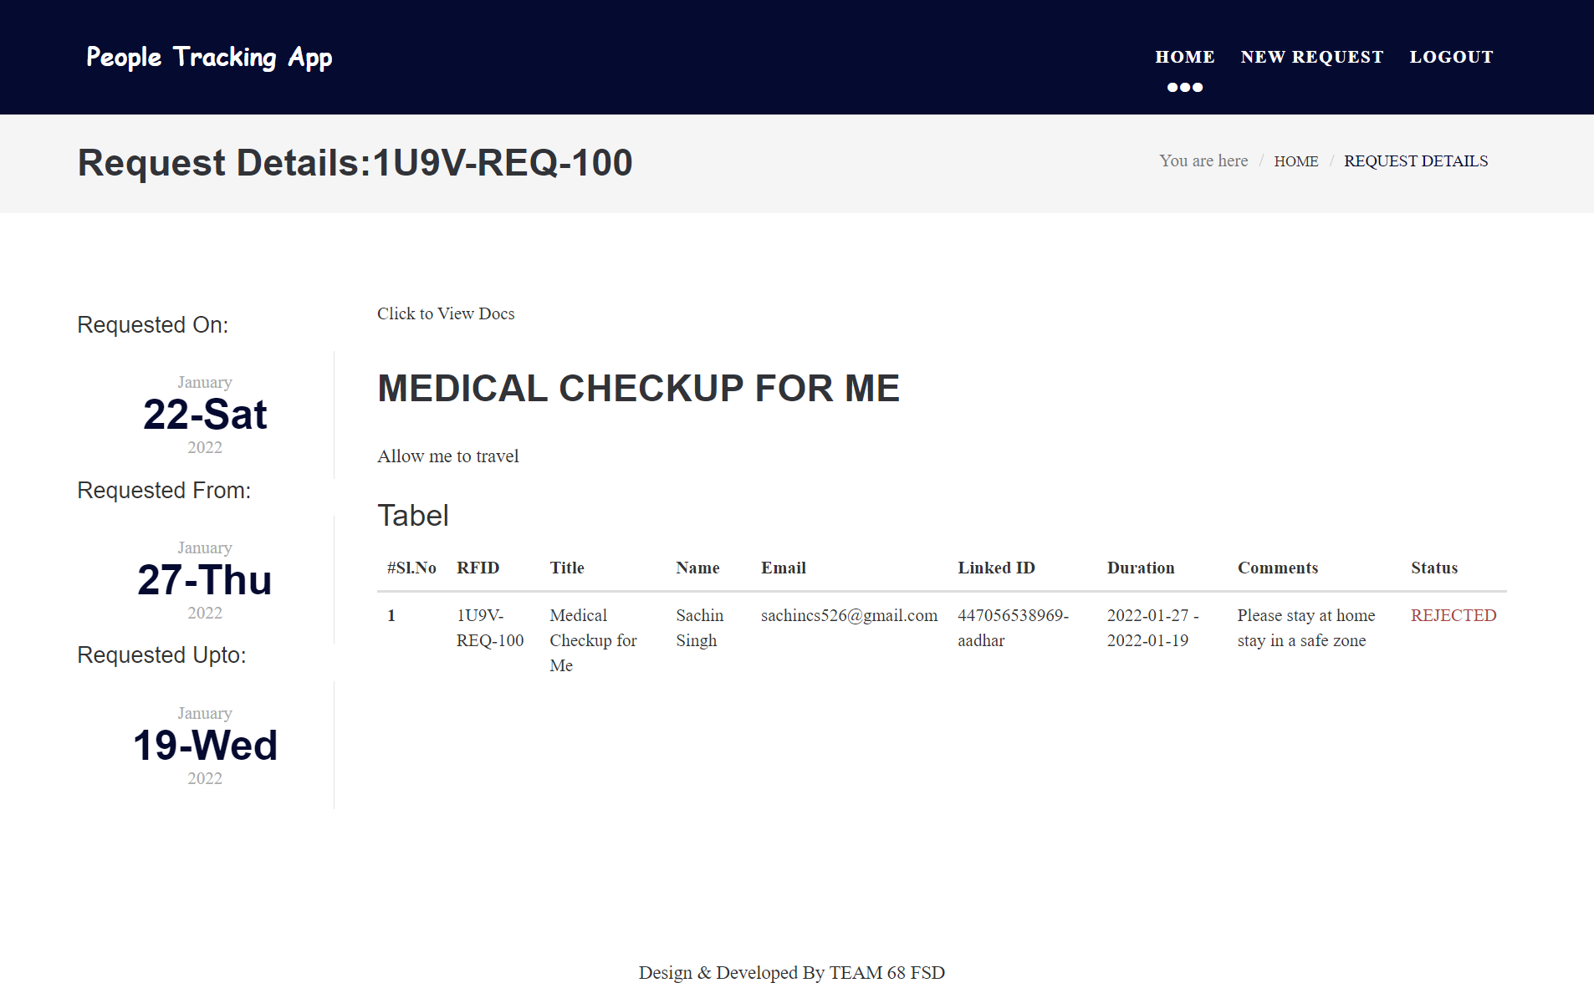
Output Screens
Check The Status

Slide 16
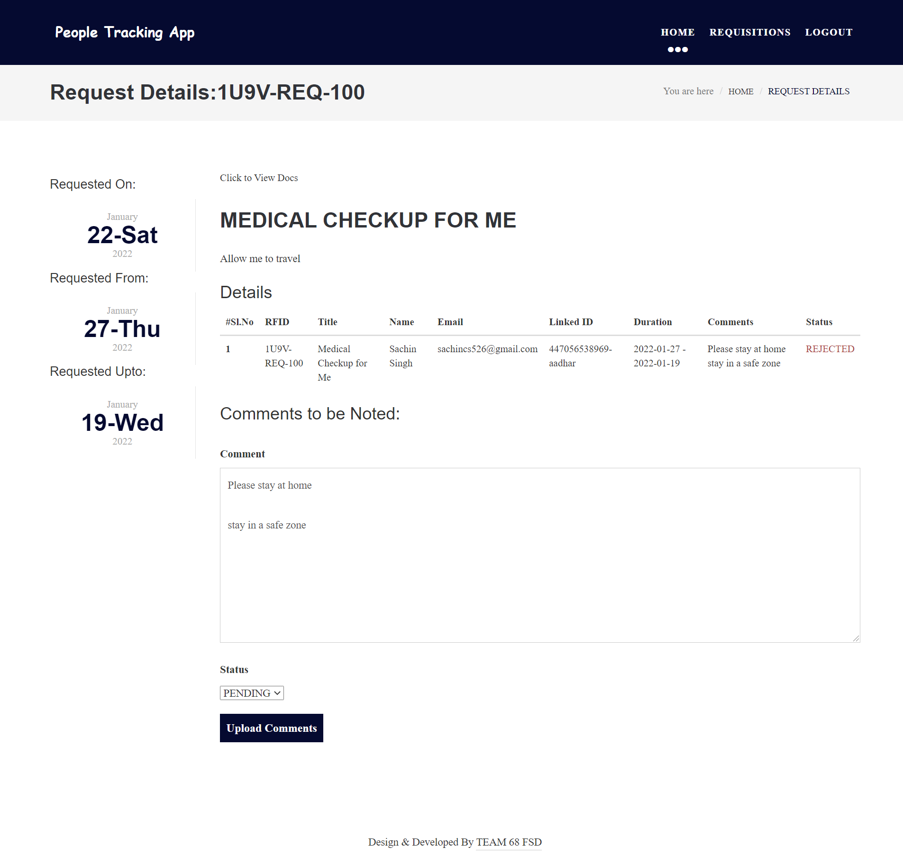
Output Screens
ADMIN
For admin we have all signup, login process as same as user but we differ both of them by admin approval method which is shown below

Slide 17
Conclusion
Hence all the details which we submitted for the project installation are can be seen in documentation. We have given our best to work as a team and we succeeded for bringing the end solution of challenges facing by organization for tracking the people. Many more features can be implemented in future with hep of AI and wide variety of API services.
We uploaded all the project files into the 000webhost file manager. Configured the database in phpMyAdmin and we were successfully hosted the application and after all validations and tests made successfully the live version of application is at:
https://geriatric-receiver.000webhostapp.com/

Slide 18

Thankyou

